Slide 1

YE STUDIOS
by Group One

Slide 2

Board Members
Daniella Muli
Eve Michelle
Pheonverah Achieng’
Naomi Opiyo
Jack Mwangi

Slide 3

Introduction:
The entertainment industry has undergone revolutionary transformation in recent years, with data-driven decision-making emerging as the cornerstone of success in film production.
Companies like Netflix, Amazon Studios and A24 have demonstrated that combining creative vision with rigorous statistical analysis produces superior outcomes compared to solely relying on industry conventions and gut feeling.
A proper case study would when Netflix greenlit their famous series titled ‘House of Cards’. This was not based on gut feeling or traditional pitches but rather the company banked on the data showing that audiences that enjoyed political dramas also had strong interests in Kevin Spacey’s performance and David Fincher’s directorial style.
As YE Studios enters this competitive landscape, we face the challenge industry leaders such as Netflix overcame i.e. how to translate vast amount of data into actionable insights that drive commercial success.
This project delves into the intricate world of cinema, examining factors that transform films into box office hits.

Slide 4
Business Understanding:
Business Context: YE Studios is entering the high-stakes global film industry. To minimize entry risk, we are deploying a data-driven framework to identify high-Return-On-Investment content and optimal financial structures.
Stakeholder Needs:
Chief Financial Officer(CFO): Budget “sweet spots” and Return on Investments predictability to protect capital
Chief Executive Officer(CEO): Brand positioning through high-quality, high-engagement content.
Board Of Investors: A risk mitigated expansion strategy based on global market demand.

Slide 5
Data Understanding & Integration:
Our analysis integrates five authoritative datasets, each offering unique dimensions of film performance:
Internet Movie Database(IMDB)-audience ratings, genre, runtime, votes(quality and popularity)
Box Office Mojo-Domestic/international revenue, studio, release timing.
Rotten Tomatoes-Critical/audience scores, rating, director(critical reception)
The Movie Database9TMDB)-Popularity score, genre IDs, original language(engagement)
The Numbers- Production budget, ROI, worldwide gross
Together, they provide a 360-degree view of what drives success, from audience sentiment to global revenue and profitability

Slide 6
Data Analysis:
Our analysis focuses on four critical domains:
Financial Optimization
Genre & Content Strategy
Market Dynamics
Competitive Positioning

Slide 7
Financial Optimization:
Presented by the Financial Analyst: Naomi Opiyo
Financial success in film often requires more than a compelling story where it demands strategic capital allocation, risk assessment, and return optimization.
This data-driven review evaluates key financial metrics including ROI by budget tier, genre profitability, market saturation, to identify high-efficiency investment opportunities and mitigate exposure in oversaturated segments
My analysis involves answering the following business questions:
What is the optimal budget range for maximum return on Investment(ROI)
Do independent(indie) studios achieve different average ratings compared to major studios, and what can we learn about indie versus blockbuster strategy
How do different financial levels correlate with average ratings and commercial success?

Slide 8
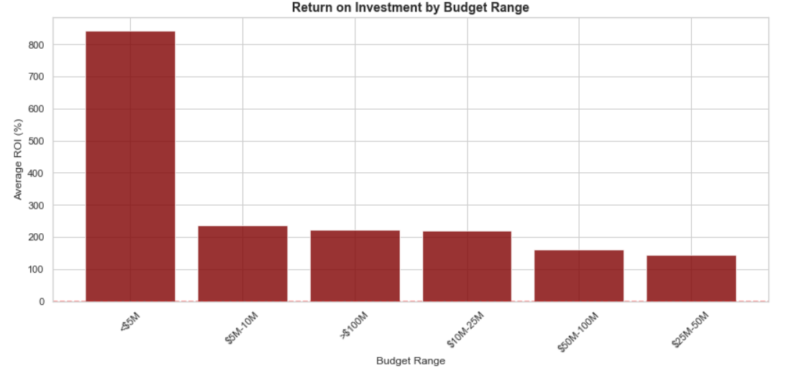
Highest ROI in the lowest budget tier:
Films under $5M yield an average ROI of 842.85% far higher than any other budget range.
Result is significant(p<0.05),meaning its not due to chance.
Despite high ROI, these films have very high variability(STD Dev~5652.50%) indicating risk.

Slide 9
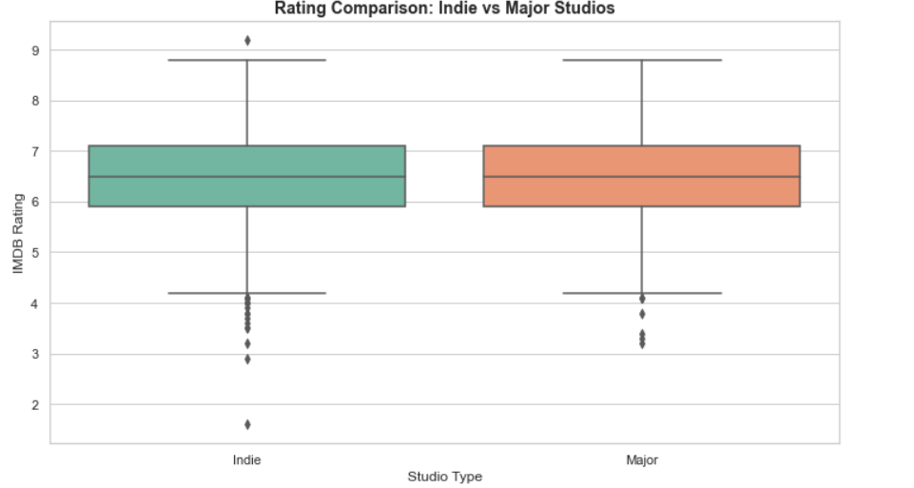
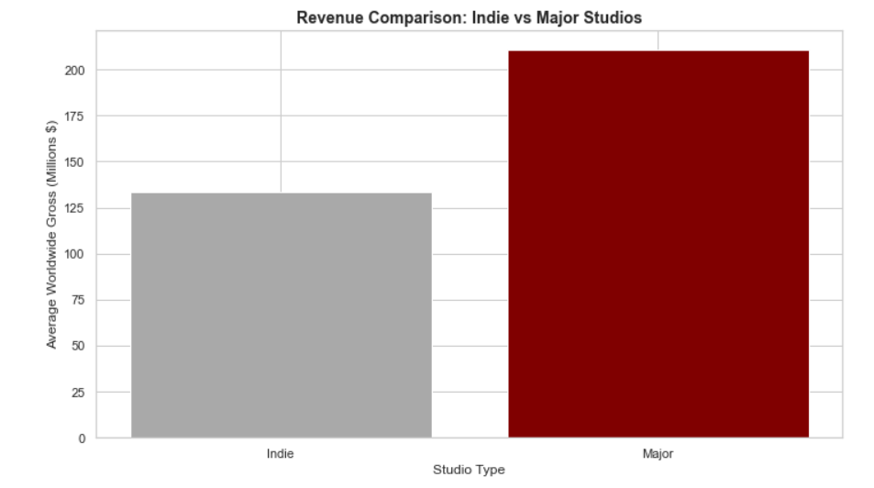
Independent(Indie) Vs Major Studios: Quality and Revenue
The Quality is nearly identical with Independent(indie) studios having an average rating of 6.46 while major studios gross a 6.45 rating(a negligible difference)
Major studios earn 58% more on average(210.9M vs $133.4M for independents(indie).
Independent(indie) can match major studios in quality, but major studios excel in monetization through marketing, distribution and scale.
Conclusion: To compete with majors YE Studios would need similar commercial infrastructure not just production quality.

Slide 10
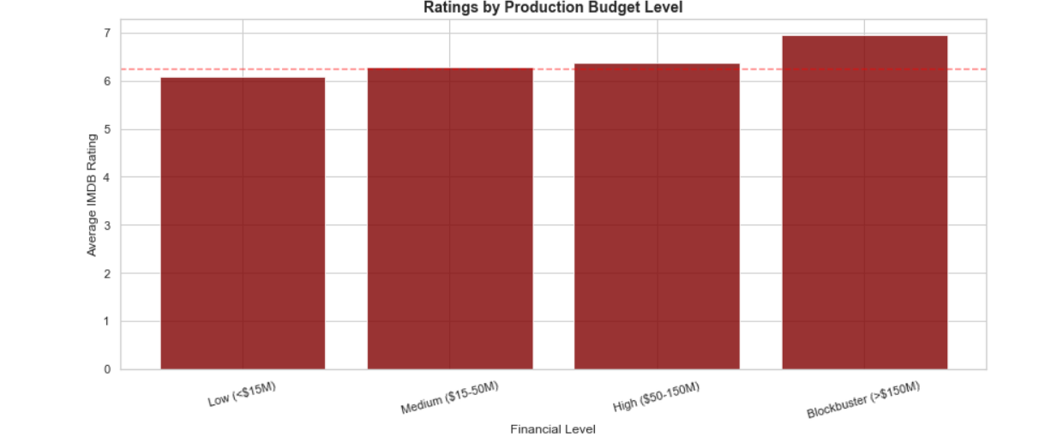
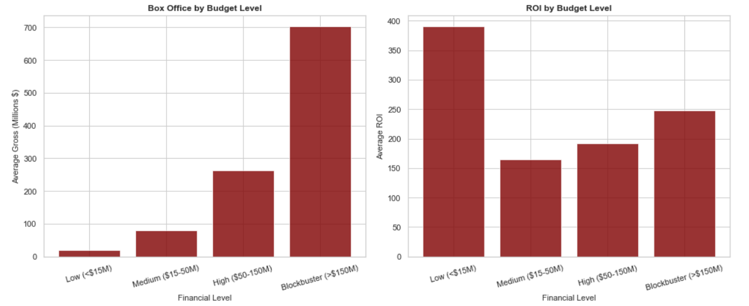
Financial Levels, Ratings and Commercial Success
Budget strongly predicts revenue(r=0.793), but weakly predicts quality(r=0.174).
Higher budgets often translate to slightly higher ratings(up to 6,95 for blockbusters), but lower ROI: highlighted through production budgets vs ROI where a low budget(<$15M) returns a 389.96% whereas a Blockbuster(>$150M) returns an ROI at 247.32%.
Rating poorly predicts revenue(r=0.223) demonstrating that success depends more on marketing, distribution, and scale.
Conclusion: Lean towards low budget films for higher ROI, or blockbuster for maximum revenue and prestige but not both.

Slide 11
Genre and Content Strategy:
Presented by the Genre and Content Strategist: Daniella Muli.
In the ever-evolving landscape of global cinema, understanding which stories resonate and where, is paramount to building a lasting content strategy. My analysis examines genre performance across revenue, audience appeal, and international markets to identify not only what works, but where opportunities for innovation and market leadership remain untapped.
I answer that by looking at the following business questions:
Which genres or specific genre combinations consistently delivered the highest global revenue, and where can we identify underserved niches with lower competition but clear audience demand.
Do certain genres demonstrate better international appeal, enabling us to maximize global revenue potential?

Slide 12
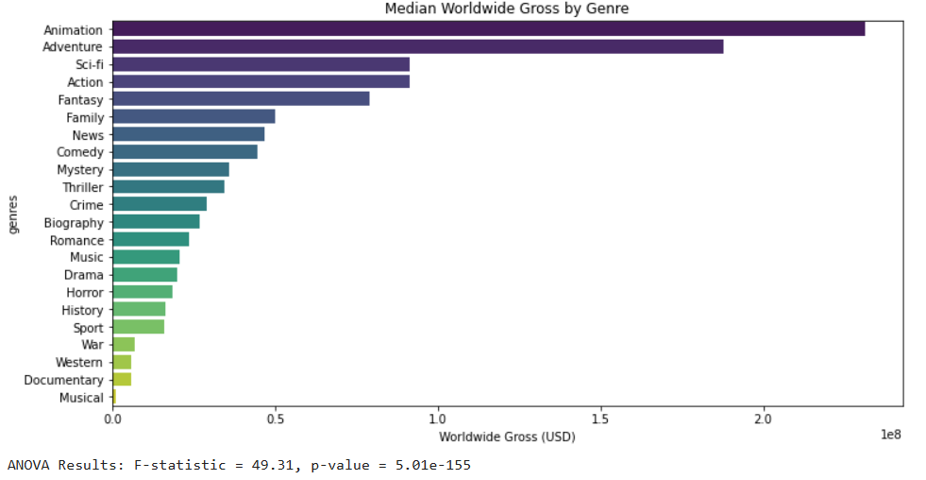
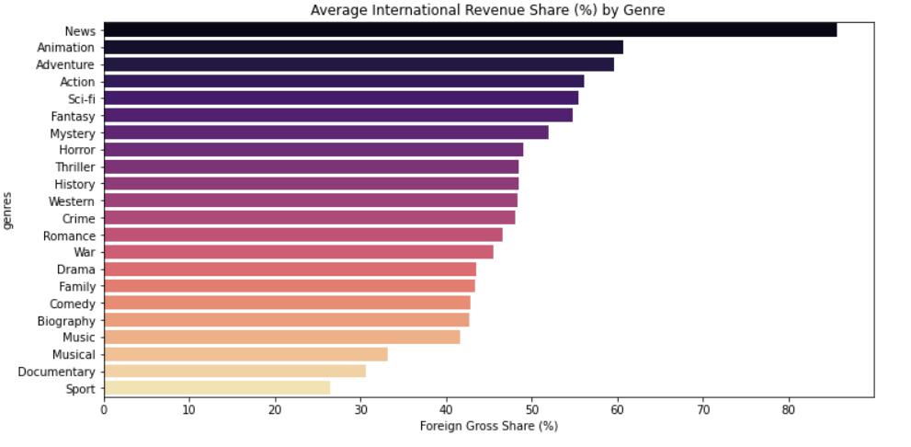
Top Genres for Global Revenue and International Appeal:
Fig 1:
Animation and Adventure genres are the strongest performers, exceeding $150-200M median gross, whilst Sc-Fi, Action and Fantasy are reliable as they produce mid-t-high revenue gross.
Fig 2:
Genres with the best International Appeal re Animation, Adventure, Action, Sci-Fi and Fantasy generating a 55-60% foreign share. Hence, highlighting that visual storytelling and universal themes travel well globally and would be ideal for global scaling.
Domestically, Comedy, Documentary and Drama have a higher share and would be better suited for domestic campaigns.

Slide 13
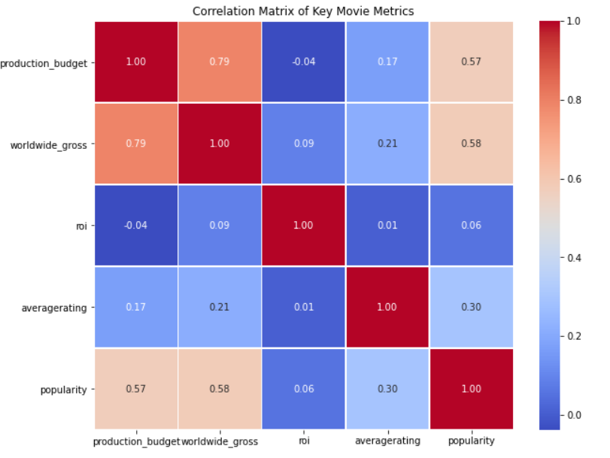
Top genres for Global and International Appeal: Cont.
The correlation gives us a quick, at-a-glance comparison off the key metrics.
It further highlights that Popularity and Budget have the strongest ties to revenue.

Slide 14
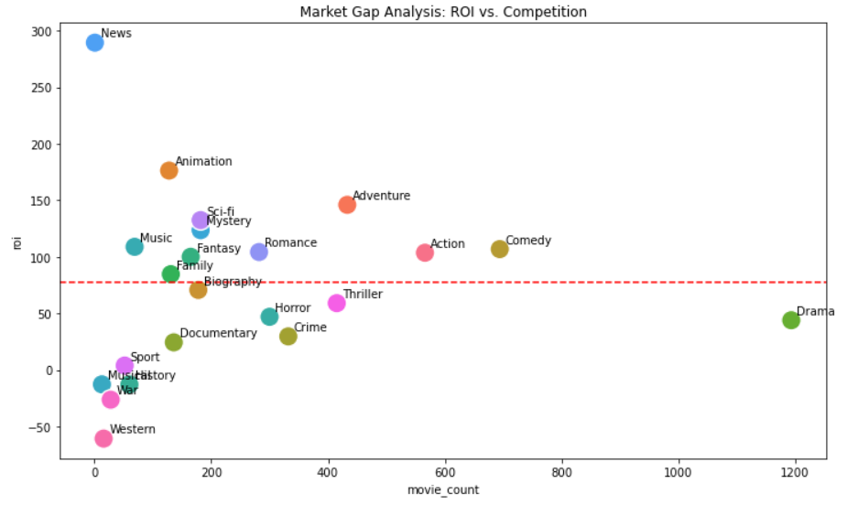
Identifying Underserved High-ROI niches.
Mystery, Horror, Sci-Fi genres have a high median ROI with lower production volume giving an opportunity for efficient capital deployment with less market saturation
Market saturation factor is further highlighted by high-competition, lower ROI genres like drama and comedy where there are many releases but lower ROI
On the other hand, the Animation genre demonstrates a high revenue but high-risk pattern because although the revenue is high the ROI is not significantly higher due to their large budgets needed for production.

Slide 15
Competitive Positioning Analysis:
Presented by the Competitive Positioning Strategist: Pheonverah Achieng’ :
In today’s globalized film market, understanding how different regions and seasons influence box office performances essential to building and maintaining a competitive edge. My analysis examines two critical dimensions:
How do domestic versus foreign markets respond differently to various genres, and should we develop region-specific content strategies?
What seasonal or temporal patterns exist in box office performance across different genres?

Slide 16
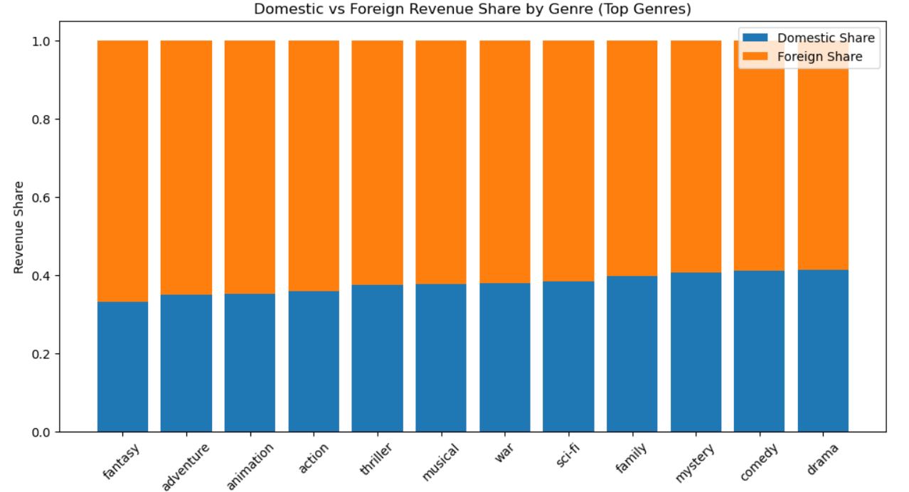
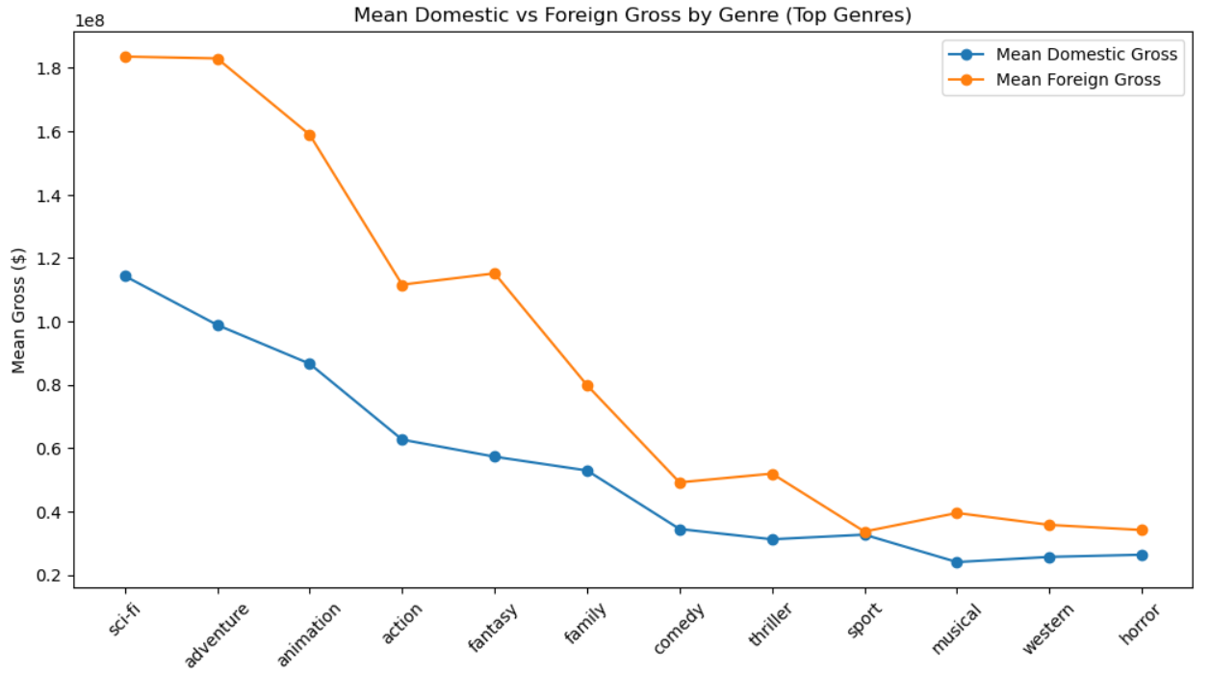
Genre Performance: Domestic Vs International Markets
Fig 1:
Foreign share exceeds domestic in every category, ranging from 56% to 65% of total revenue.
Fantasy, adventure, animation and action earn 60-65% of revenue abroad highlighting visual spectacles drives international appeal
T-tests performed show foreign revenue is significantly higher for 9 out of 10 genres(p<0.001)
Fig 2:
No genre performs better domestically as even heavy-genres like drama and comedy earn 55-57% of revenue internationally as shown
The financial impact is large and consistent as demonstrated by 95% confidence intervals show foreign revenue exceeds domestic by $2M to $97M per film, depending on genre.
Conclusion: Majority of marketing and distribution resources should be allocated to international markets for all genres, with highest international earners receiving 70-80% of foreign-focused investments.

Slide 17
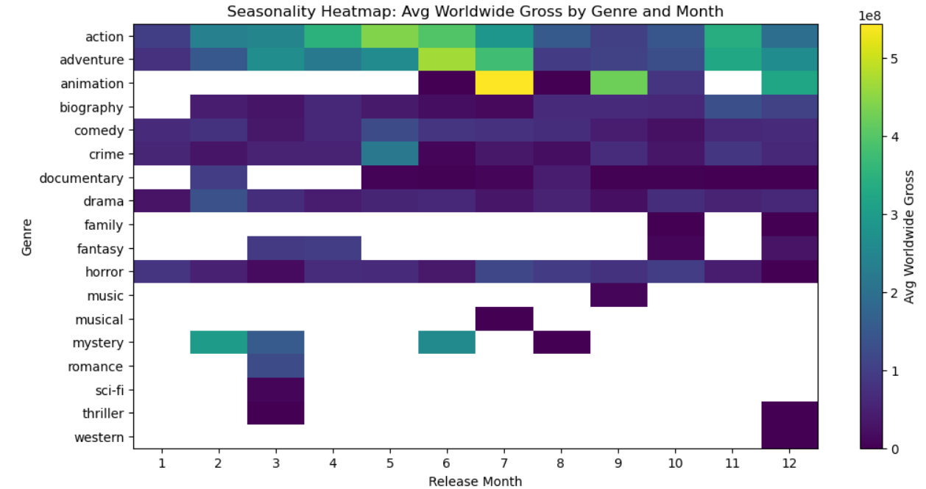
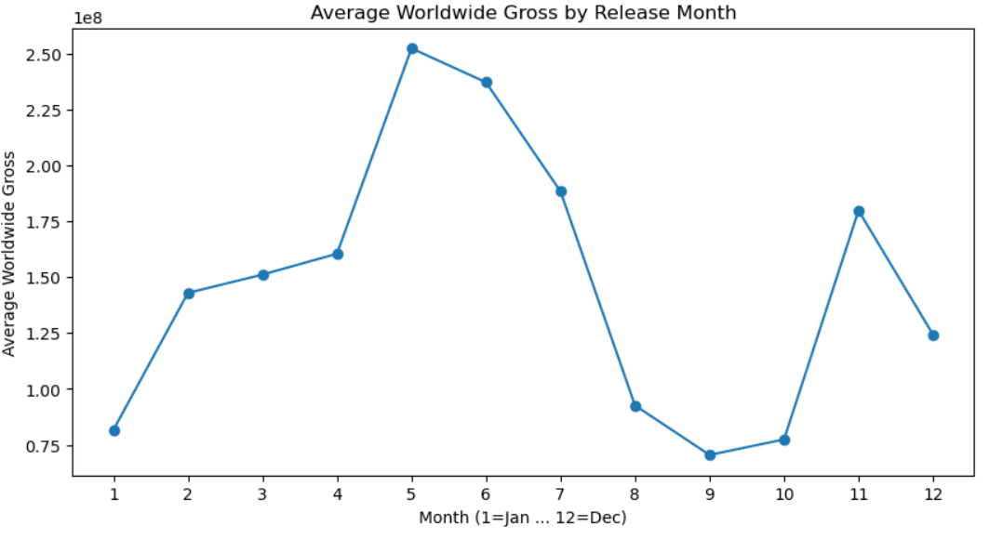
Release Timing- Maximizing Box Office Performance
Both figures:
Peak seasons;(May-July) and holiday(November-December) drive 3X higher revenue highlighted by their average gross of $190M-$225M vs. $70M-$80M in off-peak months.
Lowest-performing months see a sharp drop averaging a 72% lower revenue making them risky for major releases.
Genre performance often align with seasonality i.e. Action, Animation, Adventure peak in summer while Family, Drama, Fantasy perform best in holidays windows
Conclusion: Strategic release planning is critical: Release big-budget films in May-July or November- December, mid-budget in Spring or Dec whilst limiting low-confidence films to of-peak months

Slide 18
Market Dynamics Analysis:
Presented by the Chief Marketing Strategist: Eve Michelle :
Marketing dynamics significantly influence a film’s commercial performance. Beyond production quality, audience awareness, critic reception, an overall popularity shape whether a film succeeds at the box office.
Therefore, understanding these relationships enables YE Studios make data-driven marketing and investments decisions
I explore how critical acclaim, audience engagement, and popularity relate to worldwide revenue performance.

Slide 19
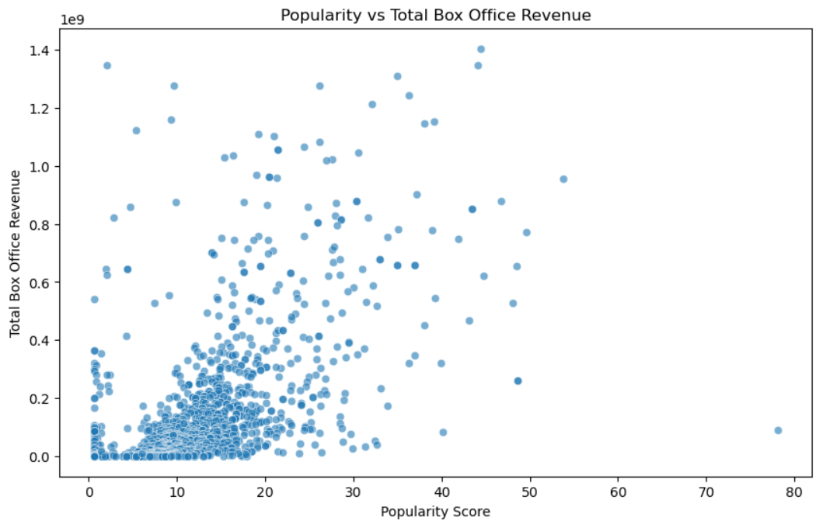
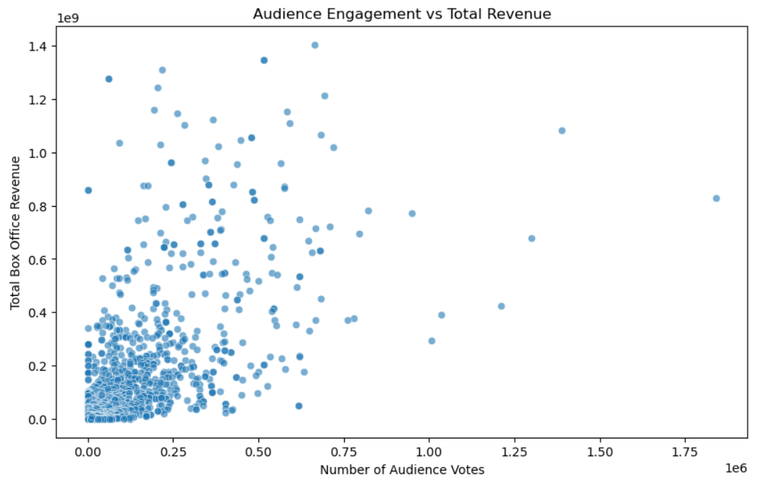
Key Drivers of Box Office Success
Fig 1:
Popularity vs. Total Box Office Revenue show the strongest correlation highlighting that higher visibility drives higher box office revenue.
Fig 2:
Like the first graph, the second graph illustrating Number of Votes vs. Revenue highlights that high engagement indicates strong word-of-mouth and awareness and equally drives higher box office revenue.

Slide 20
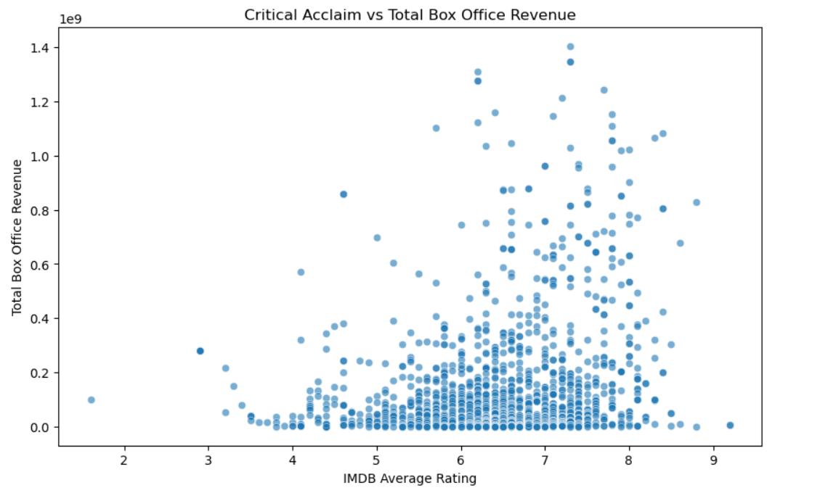
Key Drivers of Box Office Success: Cont
On the other hand, Rating vs. Revenue as shown has the weakest correlation meaning quality alone does not guarantee commercial success.
Conclusion: Marketing spend and buzz creation are essential as they impact popularity and votes, which directly boost revenue. A high rated film with low awareness will underperform and therefore YE Studios should invest in pre-release campaigns to maximize visibility and audience conversation, not just production quality.

Slide 21
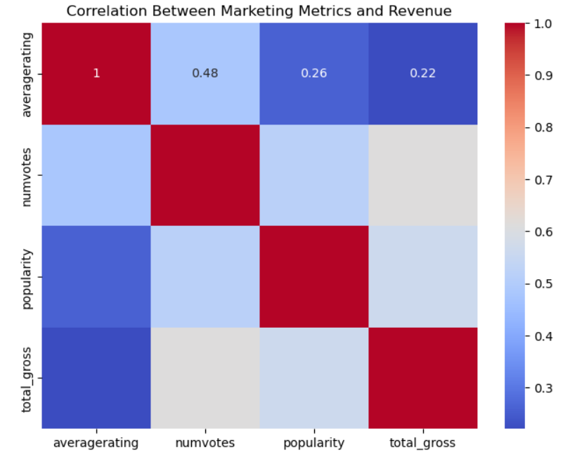
Correlation Analysis: What drives said Revenue?
As highlighted in the matrix:
Popularity is the strongest revenue driver : High correlation with total gross, emphasizing that visibility and buzz are critical for box office success.
Audience engagement(votes) matter more than ratings: Number of votes show a stronger link to revenue than average rating, highlighting the importance of word-of-mouth and conversation.
Rating has the weakest influence on revenue: Correlation is positive but low, meaning a high-rated film can still fail commercially without strong marketing.
Conclusion: YE Studios should prioritize marketing and audience hype over chasing critical acclaim alone. Pre release campaigns that boost popularity and engagement have the greatest impact on box office performance.

Slide 22
RECOMMENDATIONS:
To Chief Financial Officer(CFO):
Portfolio Strategy & Financial Optimization: Adopt a Diversified Portfolio Approach.
Tier 1(60% of slate): Films <$5M for maximum ROI (~842%)
Tier 2(30% of the skate): Films $10-25M for balanced growth and stability
Tier 3(10% of the slate): Selective $50-150M) prestige films for brand building
To Chief Executive Officer(CEO):
Genre & Content Strategy(Dual Track)
For a high Roi, focus on Mystery & Horror for consistent returns with low competition.
For Global flagships invest in Animation & Adventure for max worldwide revenue
For International focus, prioritize visual-first storytelling whilst keeping dialogue-heavy genres(Comedy) for domestic
To Board of Investors
Marketing & Distribution Strategy;
Allocate 60-8-% of marketing budgets to international markets, especially for high-travel genres9Action.Adventure,Animation,Sci-Fi)
Integrate marketing early :popularity and engagement drive revenue more than ratings
Time releases strategically: Blockbusters in May-July & Nov-Dec

Slide 23
Implementation & Expected Outcomes:
Expected Performance(Years 1-3):
Blended Portfolio ROI~410%
Capital Allocation:
$40M in <$5M films - ~$337M return
$45M in $10-25M films - ~$143M return
Reserve $150M for selective prestige projects
Key Strategic Shifts:
Reject the Indie Vs Major dichotomy:adopt independent budgets with major studio distribution.
Do not equate budget with quality: highest ROI in the lowest budget tier
Release timing is a multiplier: align genre with seasonal peaks
Market globally, produce efficiently: leverage high foreign revenue share across all genres
CONCLUSION: YE Studios can achieve profitability, growth, and prestige by balancing a data-driven portfolio, genre-specific targeting, and globally optimized marketing all underpinned by discipled financial allocation.

Slide 24
QNA Session
SWALI?

Slide 25

Thank You
by Group One
F I N I S H

